Slide 1

1
2
3
4
5
6
Smarter Cities Made Human.
A playbook for Calgary.
In partnership with

Slide 2



“You never change things by fighting the existing reality. To change something, build a new model that makes the existing model obsolete.”
Richard Buckminster Fuller

Slide 3
The Smart Cities Made Human Playbook
1
2
3
4
5
6
What’s a Smart City?
“A smart city is an urban area that uses different types of electronic data collection sensors to supply information which is used to manage assets and resources efficiently.” (Matt Hamblem)
“A smart cities approach means achieving meaningful outcomes for residents through the use of data and connected technology. This approach can be adopted by any community, big or small.“ (Impact Canada, Federal Goverment Smart Cities Challenge)
We think these definitions only scratch the surface of the opportunities & the risks presented by technology change.
We wanted to know what these risks and opportunities meant for HUMANS.
Are we up to the challenge? >>>>

Slide 4
The Smart Cities Made Human Playbook
1
2
3
4
5
6
How & Why?
DarkMatter YYC was a two month design sprint with the goal of learning what a Smart City Made Human might look like, and what principles would inform us in that work.
We started with experiments. Small, rapid & in the community that could teach us more about how technology could create humanizing, accessible and inclusive cities.
From those experiments we developed mindsets and plays that we propose as the frame for Smart Cities Made Human Calgary.

Slide 5
The Smart Cities Made Human Playbook
1
2
3
4
5
6
Mindset
=
A lense to understand
Play
=
A way to start
A mindset helps you decide what to pay attention to and how to make sense of it.
It might be a set of assumptions,
notions, philosophies or values.
A play suggests a path forward
when it may feel like there is not one.
They are helpful when the context is
shifting quickly or the territory is unknown.
A play is unfinished - it includes
wiggle room for improvisation.

Slide 6
The Smart Cities Made Human Playbook
1
2
3
4
5
6
The Mindsets
Insights
Experiments
Impact-Focus
Base solutions and policies on relevant knowledge, not assumptions. Question and test your understanding of problems because the world is changing. We need insights that emerge from the synthesis of multiple sources of information - desk research, quantitative data, stakeholder interviews, expert interviews, field observation and rapid experimentation. Insights should be guiding and answering the question:
If this is true - what then?
Experiments help you understand how things are now and to design alternative futures. By setting up a limited, controlled experiment, we can clear up assumptions and pave the way for handy knowledge and useful solutions. Experimenting is about trying out a hypothesis and testing if reality reacts as you expect it to. It is a way of acting out a solution, instead of thinking your way to it.
Development requires experiments.
To get successful results you have to be aware of the effect you want to create. What change will citizens experience because of it? To be citizen centered we need to refocus our measures on the human experience and not just the performance of a system. Impact is only possible through continuous analysis, testing and dynamic learning that adapts along the way.
From the start of a project, impact and implementation should be in focus.
!!! Inspired and adapted from our friends at MINDLAB !!!

Slide 7
The Smart Cities Made Human Playbook
1
2
3
4
5
6
The Plays
Design engagement around immersive and tangible experiences.
Make your tests small and scrappy - unlock the living labs you have.
Cultivate a city filled with everyday delights.
Coordinate initiatives with a common purpose.
Prioritize experience over efficiency.
Grow communities, networks & relationships as part of the learning journey.

Slide 8

The Smart Cities Made Human Playbook
1
2
3
4
5
6
Design engagement around immersive & tangible experiences.
Help citizens experience new technology by making it real - something that can be touched, felt, heard. Talking about what drone delivery might be like and standing in front of a mocked-up street while drones whizz by are different experiences. Use the insights from these engagements to fuel a better discussion.

Slide 9
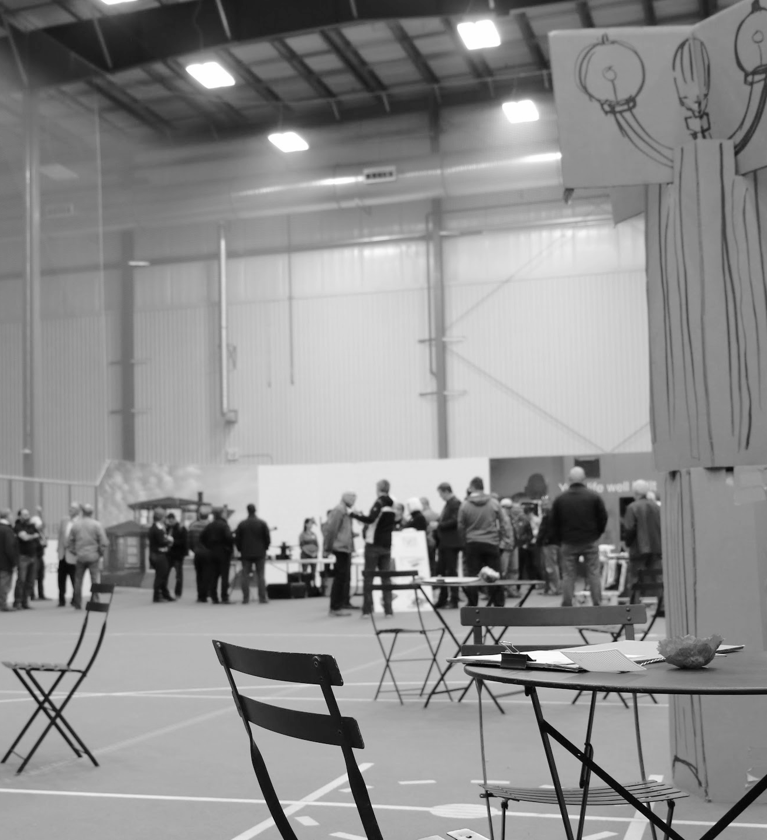
Our Experiment: Drones could radically transform the experience of public space. To understand how this might impact citizens, we mocked up a street cafe inside a soccer centre and flew drones overhead. More than 100 citizens joined the experience. It turns out drones literally “drone” - not only did the noise make conversation difficult, something about the way they catch your attention (predator prey instincts?) killed conversation.
1
2
3
4
5
6
checklist
Hack new testing grounds: Sometimes current regulations limit new technology in public space. Get creative to work with them.
Invite everyone to the party: Work to attract more than the usual suspects. Embrace a fun, playful approach to draw in new voices - you need their perspectives.
Sweat the experience details: You might not be able to recreate a full street cafe - what are the key sensory experiences you can cue to make it feel more real?
Deputize the crowd for data: Empower the people who show up to help you collect and synthesize data. What do they observe? What does it mean? What can it teach us? You don’t need experts, you need people.
The Smart Cities Made Human Playbook

Slide 10

The Smart Cities Made Human Playbook
1
2
3
4
5
6
Make your tests small and scrappy - unlock the living labs you already have.
Big institutions like government come with momentum. Even the smallest experiments start to get scaled up, complicated and unnecessarily costly. Resist that temptation and keep it simple.
Remember that our cities are already testing grounds. Eliminate unnecessary restrictions that prevent early and influential testing of new approaches and technology. This ethos can help avoid costly & time consuming failed pilot programs and prototyping expenses.

Slide 11
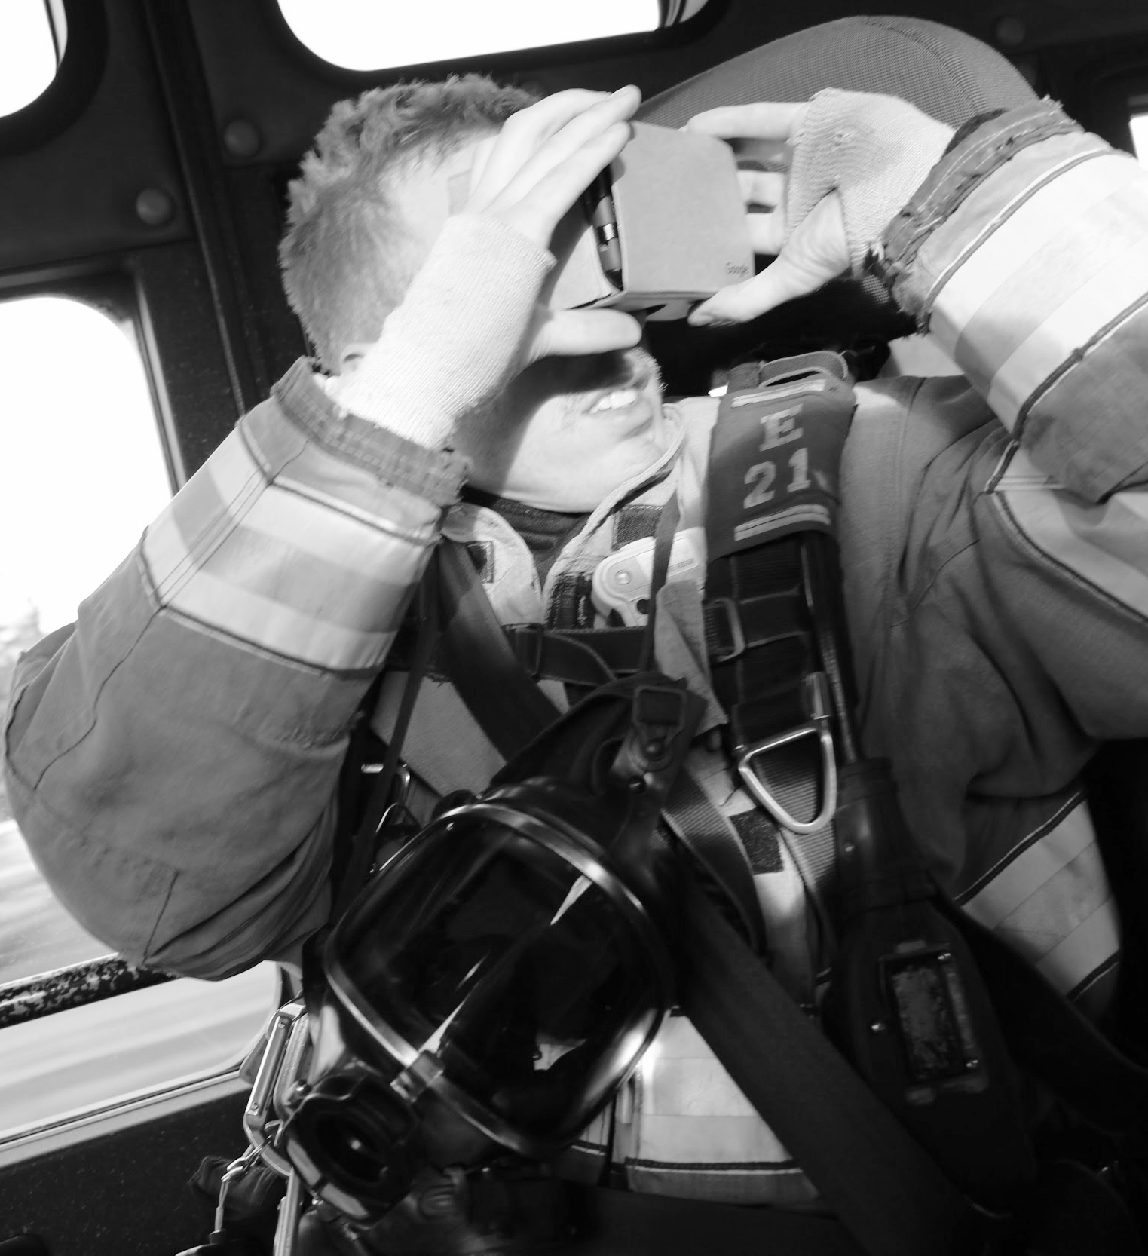
1
2
3
4
5
6
checklist
Be people sized: Set up your experiments at a person to person level. Collect and observe the (re)actions of individuals. Synthesize later.
Fight the urge to grow: Avoid scaling or complicating the test. Be sneaky. Ask for forgiveness. Call it a “test before we test.”
Dodge solutions: Spend time uncovering the human factors at play before looking for a tech solution. We jump to solutions too soon.
Notice path dependence: Are you just exploring a technology because it’s familiar? Available? Fashionable?
Play pretend: Never underestimate the power of imagination. Trust your team to fill in the experience gaps of a scrappy test & still collect powerful insights.
Our Experiment: The back of a fire truck is a complex environment. New technology isn’t always as helpful as promised. Testing a super cheap VR system loaded with Demo building models quickly made that clear. Not only did the experiment reveal problems with the tech ( strong stomach required), it catalyzed important conversations about the problem solving culture & changing data environment that could save lives during a real emergency.
The Smart Cities Made Human Playbook

Slide 12

The Smart Cities Made Human Playbook
1
2
3
4
5
6
Cultivate a city filled with
everyday delights.
Resilient cities are adaptable, not just in their infrastructure or programming, but in their people. Create public spaces that offer moments of comfort, space for reflection and unexpected joys. These spaces do not need to be permanent, they can happen spontaneously and offer opportunities for unexpected conversations and connections. Support people to be more resilient.

Slide 13
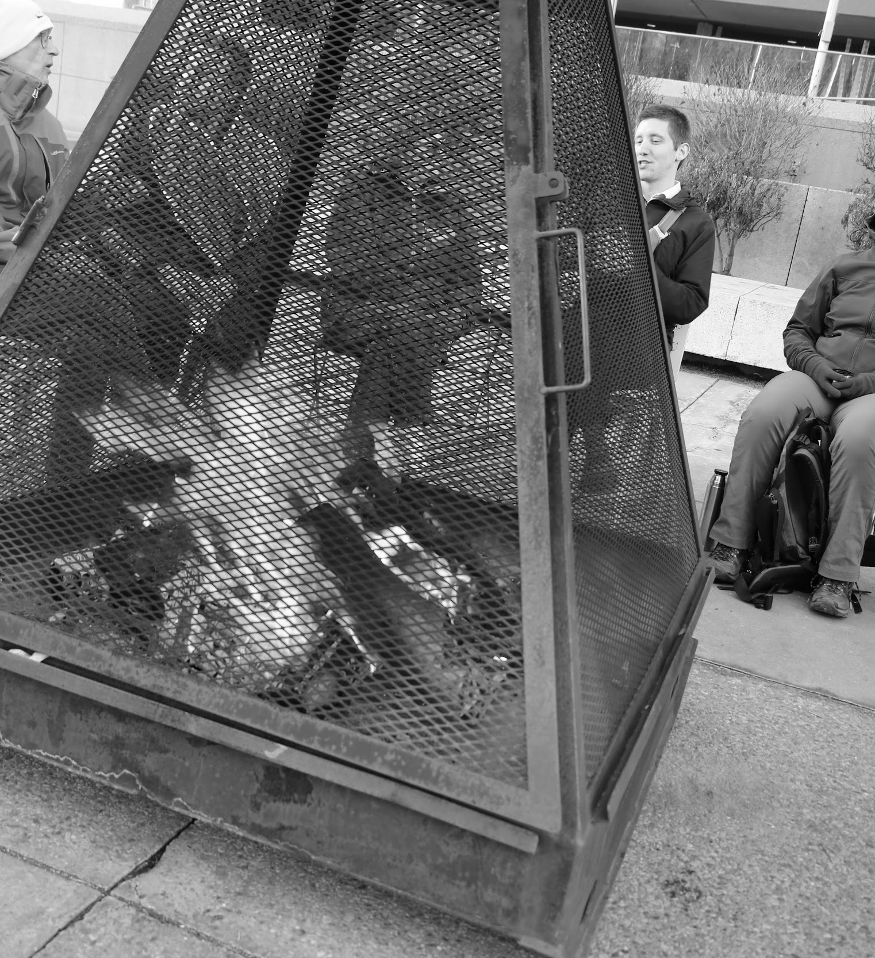
1
2
3
4
5
6
checklist
Experience first: People don’t remember every detail of their day. We are impacted most by the pits and the peaks. Strive to create peaks when redesigning city services and implementing new technologies.
Create Magic: Technology should integrate seamlessly - it should feel magical , not complicated.
Amplify, don’t replace: Simple everyday joys (like a warm coffee and people to watch) don’t need a tech overhaul. Use technology to connect and enhance.
Stay Present: Technology should help you be more present and aware, rather than less.
Our Experiment: Cozy city was an experiment in uncovering what makes a smart city a welcoming, inclusive and otherwise cozy place to live. Using existing city assets, this experiment created temporary public spaces that embody the Cozy City feeling — to prompt public conversations about the role technology might play in the public realm. Almost 50 people joined us on the steps of city hall for the first discussion. Brought together by fire (old tech) and google hangouts (new tech)
The Smart Cities Made Human Playbook

Slide 14

The Smart Cities Made Human Playbook
1
2
3
4
5
6
Coordinate initiatives with a common purpose.
A well defined and shared understanding of the problem and our purpose will enable government to rebuild its legacy systems with a human centered focus. So rally the team - find your early adopters and pull them together no matter what their department or line of business. You’re all designing with the goal of making the city more human, more livable, more beautiful.

Slide 15
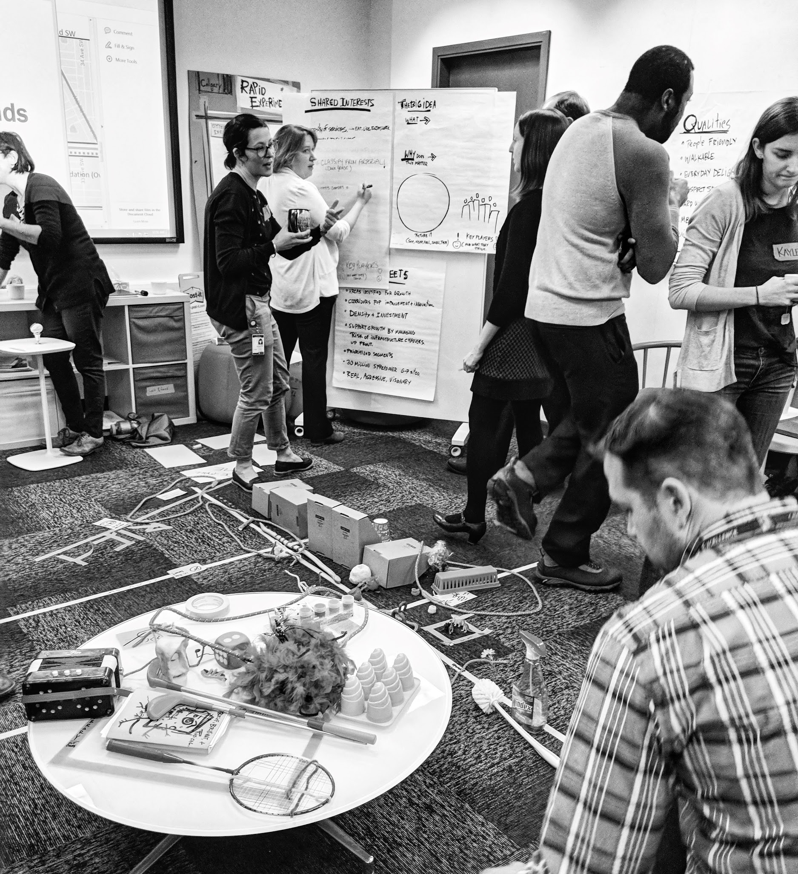

1
2
3
4
5
6
checklist
Find your early adopters: The right people for a project are the ones who put their hands up and have the energy to run with it. They can be found in unlikely places.
Collaborate in informal ways: Bring people together for a morning coffee session or a monthly meeting to explore creative methods to common challenges. It’s not a “project team” it’s a union of visionaries.
Unlock permission space: Enable staff to apply new methods to their work and to work in new ways. Report on your experiences and learnings as ways to validate participation.
Remember the person at the end of a service: Re-orient the conversation around users not processes.
Our Experiment: To bust silos and re-orient around citizen’s experience we launched an experimental working group. The tiger team has no formal mandate, but meets monthly to workshop wicked challenges. Up to 35 people representing 20 business units use design thinking methods to tackle wicked challenges. They’ve helped transform a back alley into a mainstreet street during intense construction, using transit to increase food security & improving health outcomes through pedestrian connectivity & tech.
The Smart Cities Made Human Playbook

Slide 16

The Smart Cities Made Human Playbook
1
2
3
4
5
6
Prioritize experience
over efficiency.
Designing a smart city is about more than infrastructure - investing in dark fibre to enable connectivity and data analysis is meaningless if improving the citizen experience is not at the center of technology. This also requires calibration what and how we measure success. Take a glass of clean, city water: In the past we would measure how much and how efficiently it was produced. In the future we must also evaluate how well we quenched a citizen’s thirst.

Slide 17
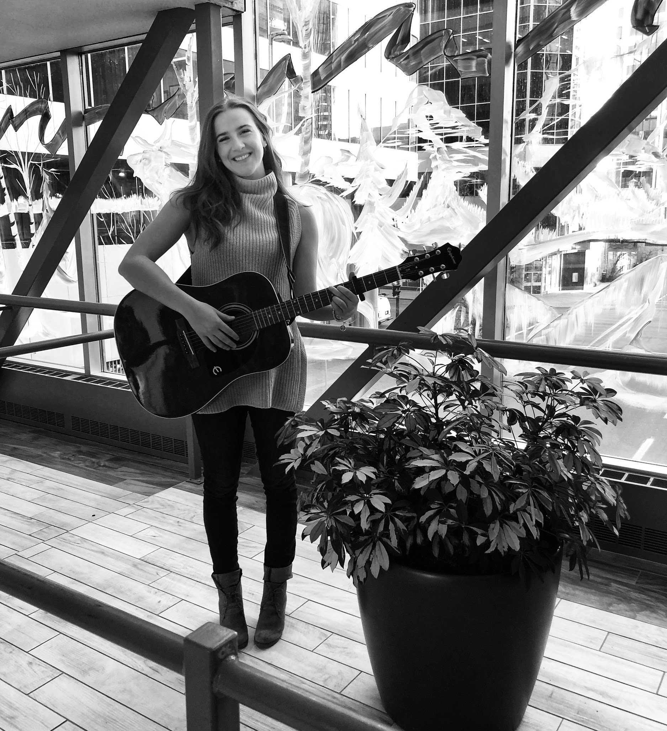
1
2
3
4
5
6
checklist
Watch what they do - not what they say: Observational research is a powerful and underused tool in government. Get out into the real world. Pick high traffic areas & unusual locations to get richer data.
Recalibrate what you measure: Build tools to evaluate the impact of a service, not just how much was delivered (how well did we quench your thirst vs. # glasses of water produced)
Embrace Empathy as a starting point: It is the ability to understand the problems and realities of others. Whenever possible involve users in your work directly.
Go beyond market segmentation: Citizens fit in more than one box. Evolve and grow your data with them.
Our Experiment: Infrastructure should change and evolve with emerging technology. Calgary has one of the largest indoor pedway systems in the world. We partnered with university innovation students and challenged them to re-imagine how this iconic infrastructure could evolve. Their ideas have system wide implications but always zoomed in to the experience of a person. The big lesson: bridges should do more than connect places - they should link, amplify and empower people.
The Smart Cities Made Human Playbook

Slide 18

The Smart Cities Made Human Playbook
1
2
3
4
5
6
Grow communities, networks
& relationships as part of the learning journey.
Cultivate relationships with economic development partners, learning institutions, private industry and small startups. Use partnerships to unlock new avenues for co-funding, access to testing facilities and resources for learning. By bringing the community along the learning journey from the outset you will design a common vision for a smart city that needs all partners to be successful.

Slide 19
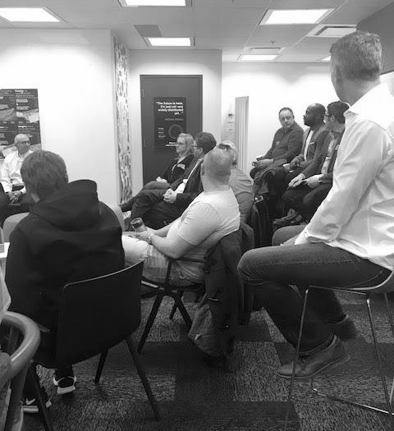
1
2
3
4
5
6
checklist
Relationships are learning opportunities: Governments cannot operate in a bubble and they cannot be everywhere at every moment. Connecting with our partners grows our understanding of our community, our citizens.
Be open to co-resourcing: Sharing resources to test pilots can be a powerful way to learn. This might mean offering government assets as testing grounds or working hand in hand with academics to dig into an unknown topic.
Make transparency your de-facto principle: Opening our data and our systems to entrepreneurs and industry means more minds and more creative solutions to our most pressing challenges.
Our Experiment: Blockchain technology is something the government knows it should look at, but it’s no expert in the space. By engaging 17 leaders in Calgary’s blockchain community for a coffee chat, we learned that government cannot sit on the sidelines and wait to see what happens. The community is moving quickly in the space and expects leadership from government. In partnerships, there are opportunities.
The Smart Cities Made Human Playbook

Slide 20
List of Experiments
Co-Creators
Block Coffee - Exploring & initiating blockchain technology conversations.
Cozy City - Using technology (old and new) to transform the public realm in a winter city.
Plus 15’s X 6 - University student experiments in the city owned infrastructure
iBeacon Living Lab Skywalk - Open technology platform for citizens to experiment
BIM + FIRE + VR - Providing immersive building data through virtual reality in the back of a fire truck
Drone Fly Zone - Indoor drone lab & streetscape experience.
Tiger Team - Cross corporate action & learning network to tackle emerging human centered design problems, smart cities technology & health.
Vivacity - Post secondary lead student challenge exploring the intersection between technology, light & social innovation.
Open Minds + Light - Primary school collaboration exploring ideas for transforming neighborhoods with light & technology.
Mug Club X 10 - Grassroots cross corporate discussions about emerging technology issues.
Civic Accelerator Experiment: Developing new procurement models for emerging precomercial technologies.
Hello World - Permanently increasing youth perspectives & voices in government blockchain verified documents.
Voluntokens - Building a transparent public database to track volunteer work & impact using blockchain technology.
We’d like to thank the following collaborators and advisors who helped explore the dark matter behind smart cities technology - and how to make it more human. We’ve just scratched the surface. Without you it wouldn’t have been possible.
-The City of Calgary
-Mount Royal University
-SAIT Drone Lab
-City of Edmonton Winter City Team
-Civic Tech Calgary Community
-Vivacity
-Calgary Fire Department
-Livable Streets Team
-Calgary Recreation
-Corporate Analytics & Innovation
-University of Calgary
-ATB Financial
-Benevity
-National Research Council
-The Tactical Urbanism Tiger Team
More than 300 Citizens, 50 Students, 100’s of municipal government staff, And so many more...

Slide 21
notes...

Slide 22
notes...

Slide 23
notes...

Slide 24
“You never know, every scenario is unique - you have to really think about that. In lots of workplaces process is really linear, this work is so dynamic, no day is ever the same, no call is the same.
The biggest danger is to assume - so we have to rely on teamwork - assessing a situation together and problem solving. We don’t work alone. We need to be “seeing” the same picture.”
Staff reflections after a rapid experiment.
The Smart Cities Made Human Playbook

